Slide 1
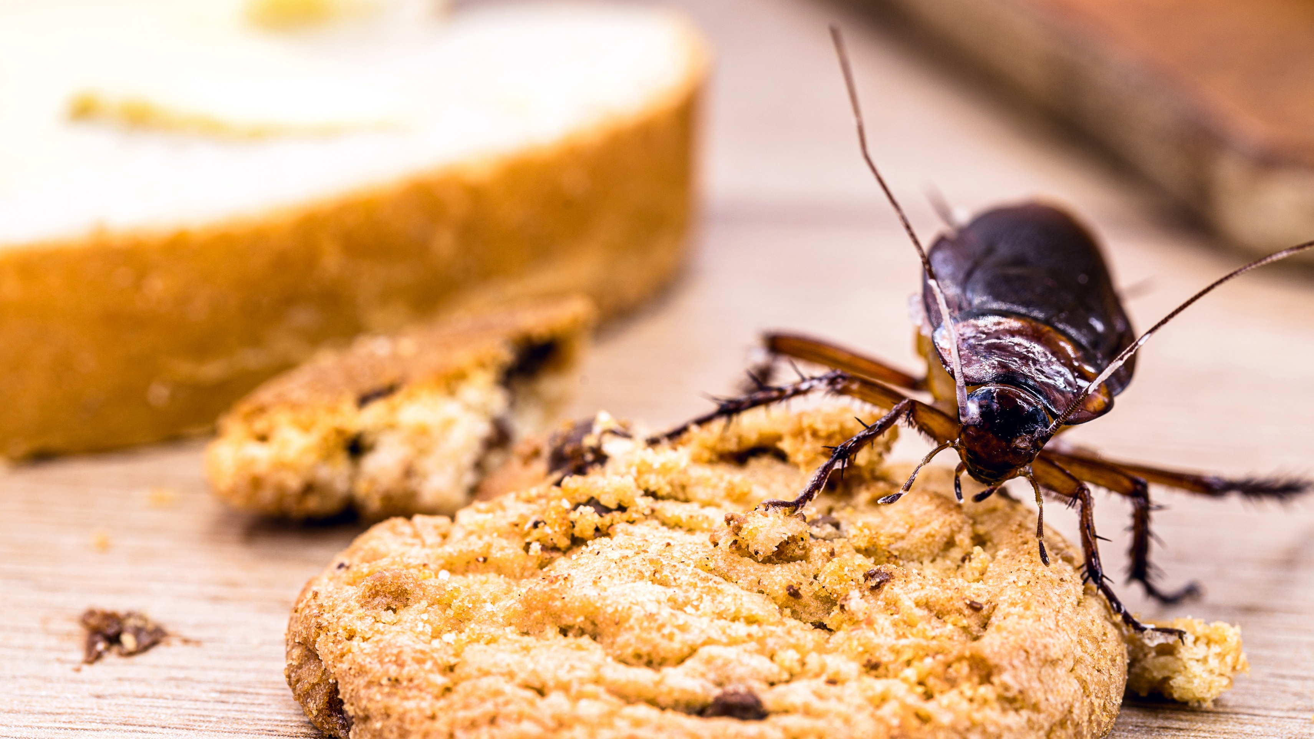
Food Safety Training
FST-13 Pest Control

Slide 2
Pest Control
Introduction
Controlling pests is vital for reducing food waste, ensuring food safety, and safeguarding public health.
It is essential for Sodexo and our clients to invest in professional commercial pest control.
An effective pest management program helps protect our business from financial losses and enhances employee productivity.

Slide 3
01
  Impact of Pests
    What is a pest?
    What are the food hazards associated with pest?
    What are some of the risks associated with pests?

Slide 4
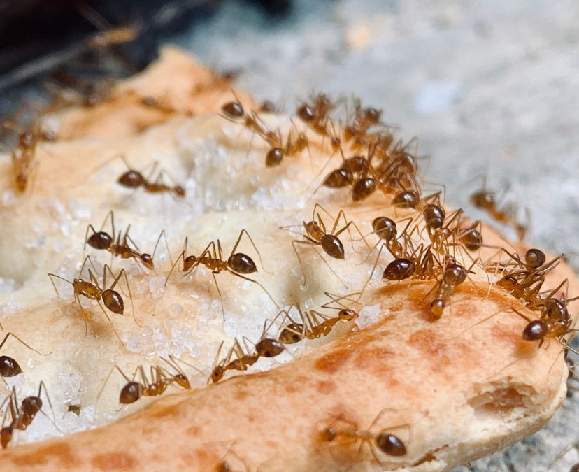

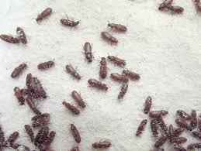
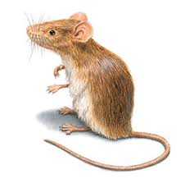
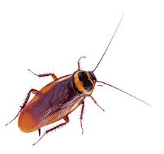
What is a pest?
Pests are any organisms (including plants and animals) that pose health, environmental, economic, or aesthetic risks (USDA)
Food pest would include rodents, insects, and birds
A pest is any creature that you don't want in your food establishment, such as cockroaches, flies, ants, weevils, mice, or rats.
Pests can harm your business's reputation, damage your facilities and inventory, and carry harmful diseases, including foodborne illnesses

Slide 5
What are the food hazards associated with pests?
Contamination: Pests can contaminate food with their droppings, urine, hair, or feathers. They can also spread harmful bacteria like Salmonella and E. coli.
Disease: Pests can spread diseases like salmonellosis, hantavirus, and cholera.
Damage: Pests can damage food supplies and the structures of food processing facilities. Additionally, they can chew through electrical wires.
Allergy symptoms: Cockroaches can trigger allergy symptoms and asthma.
Reputation: The presence of pests may diminish customer trust in a business.

Slide 6
What are some of the risks associated with pests?
Pests can contaminate food with dead bodies, nesting materials, and droppings.
Rats and mice carry fleas, mites and ticks as well as bacteria and viruses that can cause serious illness, such as Salmonella and E. Coli, etc.. Their urine can contaminate food and food packaging. This may cause a range of symptoms from mild flu to jaundice and kidney failure.
Cockroaches can spread diseases such as dysentery, typhoid and polio.
Birds can carry bacteria such as Salmonella and Campylobacter.
Flies can carry bacteria and viruses and transfer contaminants wherever they land.

Slide 7
02
  Preventing Pest Infestation
    Signs of Pest Activity
    Effective ways to prevent pest infestations
    Reporting & Pest Control Procedure

Slide 8
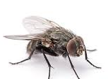
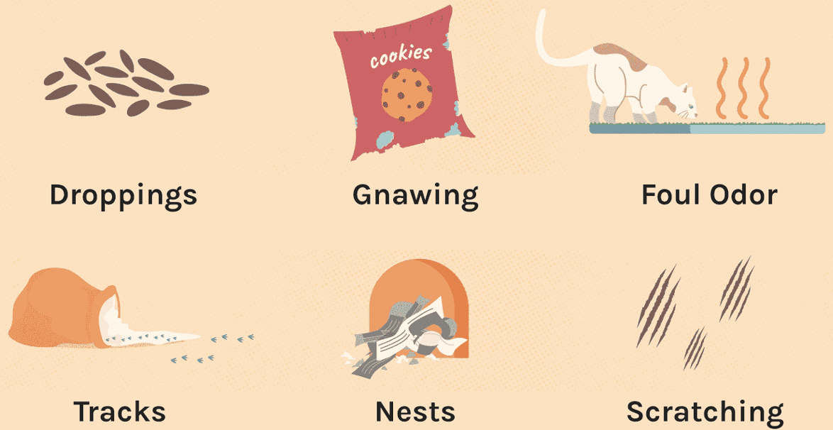
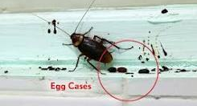
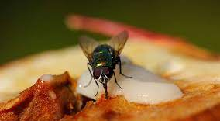
Signs of Pest Activity
  It is essential to recognize signs of pests to determine if you have an infestation. Below are three common pests and indicators of their presence:
Signs of Rodents
Signs of Cockroaches
Signs of Flies
Notes:
In addition, it is essential to recognize signs of pests to determine if you have an infestation. Below are three common pests and indicators of their presence:
Signs of Rodents
Droppings, which have a distinctive size and shape for each species
Smear marks, along runs caused by their oily fur
Gnawing of building materials, wiring, food and packaging
Tracks in dust or powder
Noises such as squeaks, gnawing sounds, scurrying sounds
Urine stains left by both rats and mice can be detected using UV light
Signs of A Cockroach Infestation
Droppings. Different species of cockroaches leave different types of droppings. ...
Smells. Some species of roaches give off a musty, oily, moist, unpleasant odor. ...
Discarded Skins. ...
Smear Marks. ...
Egg Capsules. ...
Bugs (Live or Dead) ...
New Allergy Symptoms. ...
Signs of Feeding.
Signs of a Fly Infestation
Small dark clusters of spots - in light areas (the size of a pinhead)
Regular sighting of flies - around your home, food or bins.
Maggots – these are flies in their larval stage and could indicate a potential breeding site on your property.

Slide 9
What is the most effective way to prevent pest infestations?
  The most effective way to manage a pest infestation is to prevent it before it starts. There are three primary methods to prevent and control the presence of insects, rodents, and other pests:
1. Deny Pests Access (Exclusion)
  To prevent pests from entering your establishment, it's important to eliminate potential entry points. This includes sealing holes in walls and ensuring doors remain closed as much as possible.
Additionally, inspecting food shipments for signs of pests and rodents can further help keep these unwanted visitors out.
2. Eliminate Sources of Food, Water, and Shelter
Pests are constantly searching for food, water, and shelter. By removing these essentials, you can deter them from entering and staying in your food establishment/foodservice operations.
3. Work with Licensed Pest Control Operator
Working with a pest control operator is vital for safely eliminating pest infestations in your food establishment/foodservice operations. These professionals have the expertise to identify pests and assess the problem's severity.

Slide 10
Reporting & Pest Control Procedure
Front Line Employees:
If you notice a pest or see signs that you may have a pest infestation:
Report pest sighting to your Managers or Person-In-Charge (PIC).
Fill-out the Pest Activity/Sightings Log with the following details:
  Date: Document the date of the activity/sighting
  Time: Document the time of the activity/sighting
  Pest Sighting: Document the pest activity that was observed (ex: live cockroach, ants, mouse droppings)
  Location: Document the location where the activity was observed
  Comments/Observation: Document any additional information that may be useful for the Pest Control Operator (PCO)

Slide 11
Reporting & Pest Control Procedure
Managers/Person-In-Charge (PIC):
When Pest Activity is Observed
Contact your Pest Control Operator (PCO) immediately.
Provide your PCO with details about the time, date, and location of the sighting, as well as any indicators of pest problems. The more information you share, the more effective their visit will be.
Make sure to share where the Pest Activity/Sightings Log is located for the PCO to get the information on pest activity.
If treatment is necessary in your establishment, ensure that your PCO has the appropriate tools and approved pesticides to safely address the issue while protecting your food and equipment.
Any recommendation from the PCO must be completed and documented.
By learning how to prevent pests from entering your establishment, actively observing for signs of infestation, and knowing how to respond if a problem arises, you and your employees can maintain a healthy and safe working environment.

Slide 12
Conclusion
Maintain active communication with your client if they have responsibility for the pest control program. Reports must be kept on file for 1 year, all corrective actions documented, closed, and available for review by auditors.
It is essential to implement comprehensive pest control measures to protect against health hazards and uphold a positive reputation.
By focusing on prevention and proactive strategies, we can create a pest-free environment for both customers and employees.

Slide 13

03
  Knowledge
  Check?

Slide 14
Knowledge Check: Pest Control
Circle either True or False
True False
Pests are any organisms that pose health, environmental, economic, or aesthetic risks
2. True False
You do not need to report signs of pest or pest activity because the pest control operator (PCO) will find the pest infestation.
3. True False
The most effective way to prevent pest infestation is to deny access (exclusion); eliminate sources of food, water, and shelter; work with a licensed pest control operator.
4. True False
All employees must fill-out the Pest Activity/Sightings Log whenever they notice any pest activity in the foodservice premises.
5. True False
Pests can harm your business's reputation, damage your facilities and inventory, and carry harmful diseases, including foodborne illnesses

Slide 15
Knowledge Check: Pest Control
Circle either True or False
True False
Pests are any organisms that pose health, environmental, economic, or aesthetic risks
2. True False
You do not need to report signs of pest or pest activity because the pest control operator (PCO) will find the pest infestation.
3. True False
The most effective way to prevent pest infestation is to deny access (exclusion); eliminate sources of food, water, and shelter; work with a licensed pest control operator.
4. True False
All employees must fill-out the Pest Activity/Sightings Log whenever they notice any pest activity in the foodservice premises.
5. True False
Pests can harm your business's reputation, damage your facilities and inventory, and carry harmful diseases, including foodborne illnesses

Slide 16

04
  Questions?
Notes:
Ask employees if they have any questions on the topic that was discussed during the food safety training session.

